Slide 1


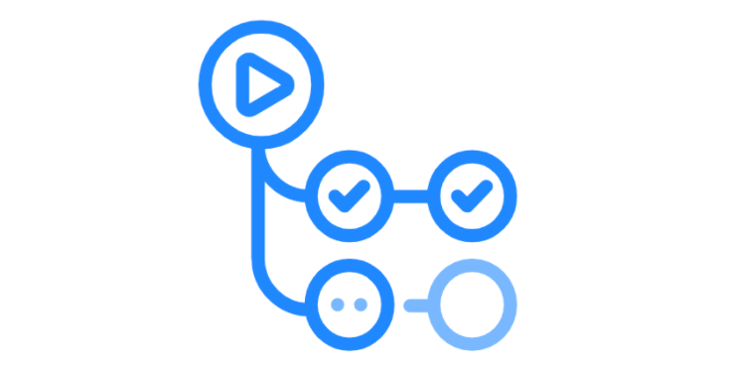









Automated BigQuery Transformations with dbt, Airflow, Kubernetes, and GitHub Actions
Actions
Docker Hub
KubernetesPodOperator
Dockerfile
update
DAGs Sync
Node 1

Slide 2
WORKFLOW
Initialize Kubernetes: Start by activating the Kubernetes cluster with docker desktop, setting the stage for the data pipeline.
Set Up Tools: Install key components: kubectl for command-line operations and Helm for package management.
Configure Kubernetes Dashboard: Establish a user interface for Kubernetes as a pod, enabling efficient management of cluster resources.
Deploy Airflow Pods: Roll out Airflow pods within Kubernetes, laying the groundwork for workflow orchestration.
Establish Log Persistence: Implement a system to ensure that logs are maintained persistently, critical for troubleshooting and analysis. Using PersistentVolumeClaim and ClusterRoleBinding.
Install dbt-BigQuery: Seamlessly set up dbt for BigQuery to leverage powerful data transformation capabilities.
Set up Big Query -GCP
Set up Docker Hub: create or log in your account and create a repository, making available a space where push the tagged image.
Containerize the dbt Project: Package dbt project into a container, readying them for deployment, through dockerfile to Github actions where is build and pushed to Docker hub.
Orchestrate CI/CD with GitHub Actions: Automate the integration and deployment process, streamlining updates and changes to the pipeline. Recieving changes into the dbt project, triggers the build and push of the dockerfile containing the latest project version and making it available in docker hub to Airflow's DAG from Kubernetes.
Synchronize DAGs with GitHub: Enable real-time updates of Directed Acyclic Graphs (DAGs) via GitHub, ensuring the workflow reflects the latest codebase.
Run DAGs from Kubernetes: Activate the full automation potential by executing the DAG from Kubernetes, where the KubernetesPodOperator fetches the latest Docker image from Docker Hub. This image, equipped with dbt, runs the complete sequence—dbt run, dbt seed, and dbt test. A temporary pod is spun up for the duration of the transformations, with the results persisting in BigQuery, exemplifying end-to-end automation in action.

Slide 3
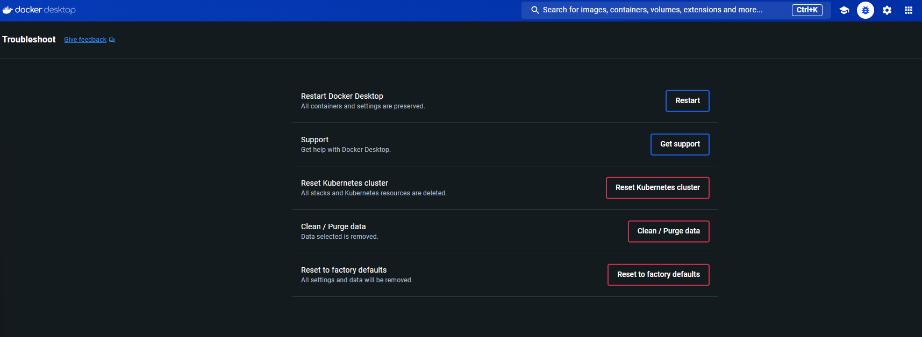
1. INITIALIZE KUBERNETES
Open Docker Desktop as Admin
Reset to factory defaults

Slide 4
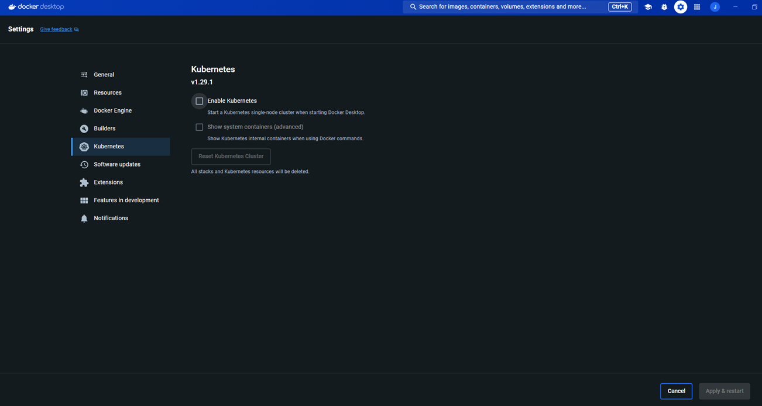
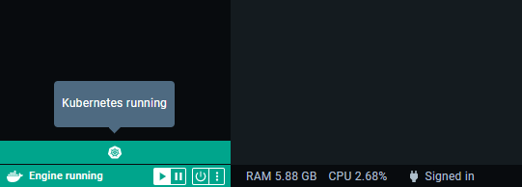
1. INITIALIZE KUBERNETES
Enable Kubernetes
Apply & restart
Wait until running-see bottom left

Slide 5
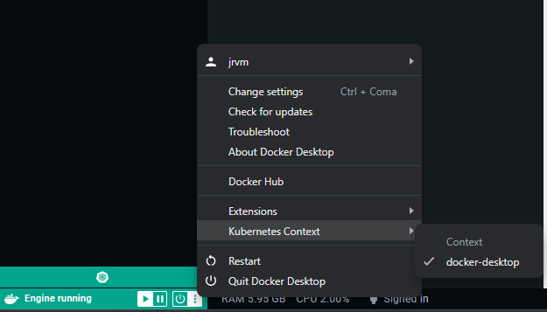
1. INITIALIZE KUBERNETES
Ensure the kubernetes context is set as Docker-desktop

Slide 6
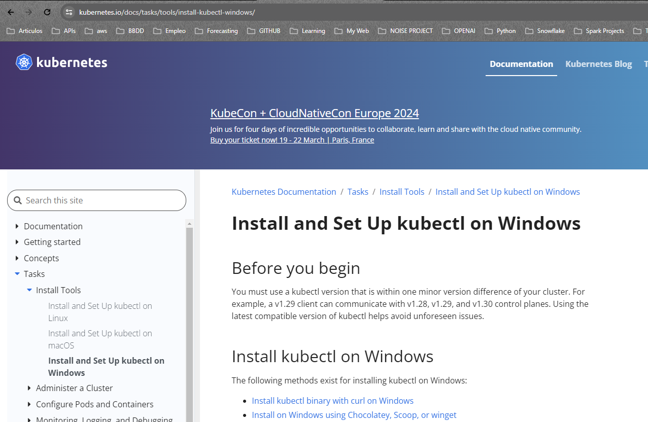
2. SET UP TOOLS
Kubectl: follow the great official guide -> https://kubernetes.io/docs/tasks/tools/
In my case I choosed Windows

Slide 7
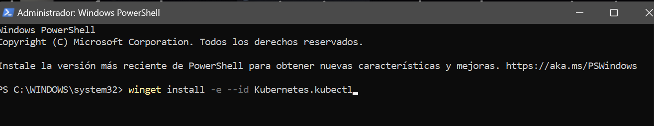
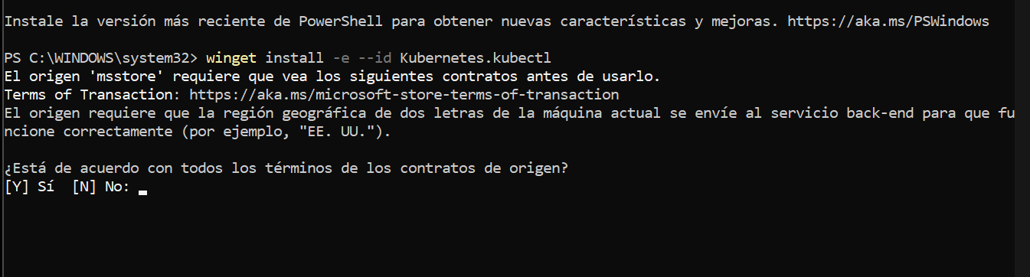
2. SET UP TOOLS
Kubectl: follow the great official guide -> https://kubernetes.io/docs/tasks/tools/
> winget install –e –id Kubernetes.kubectl
> Type : Y
Wait for downloading

Slide 8
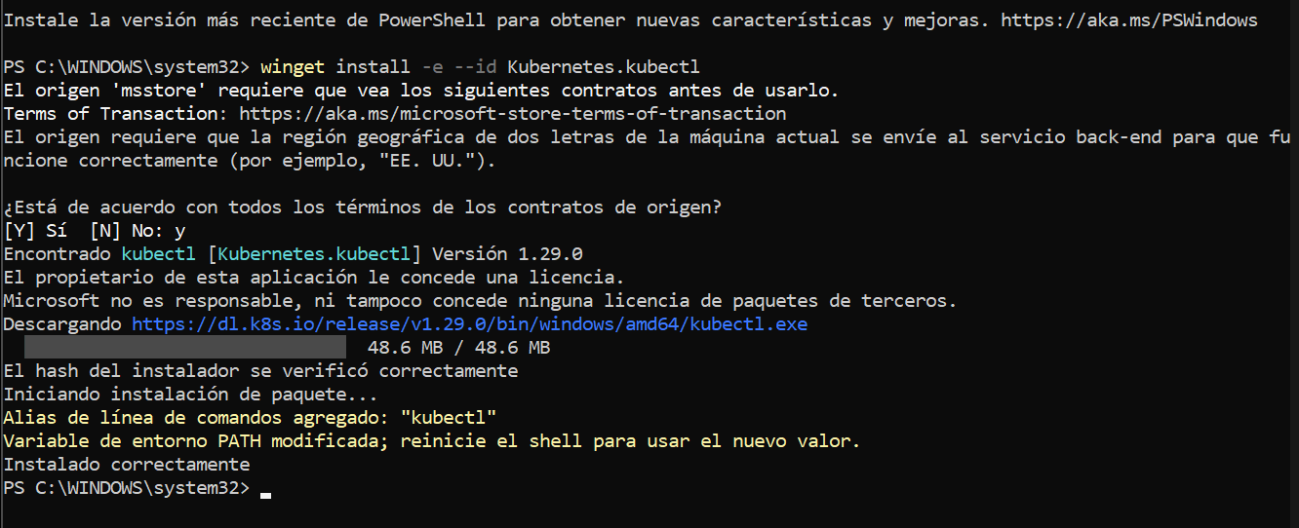
2. SET UP TOOLS
Kubectl: follow the great official guide -> https://kubernetes.io/docs/tasks/tools/
Wait for downloading

Slide 9
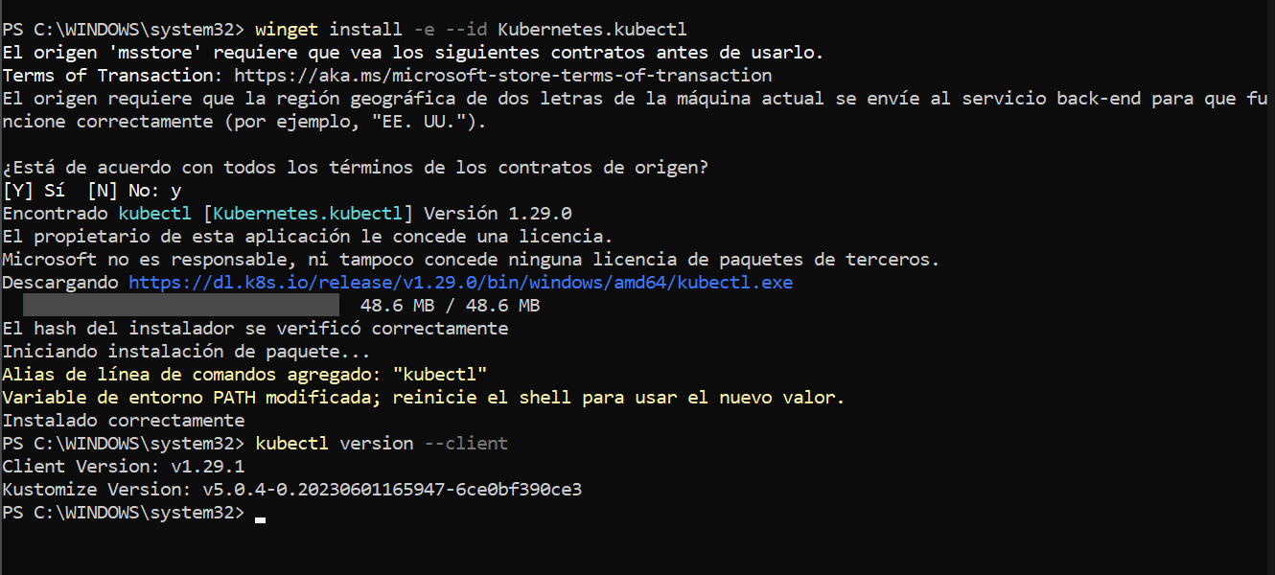
2. SET UP TOOLS
Kubectl: follow the great official guide -> https://kubernetes.io/docs/tasks/tools/
Confirm installed versión:
> kubectl version --client

Slide 10
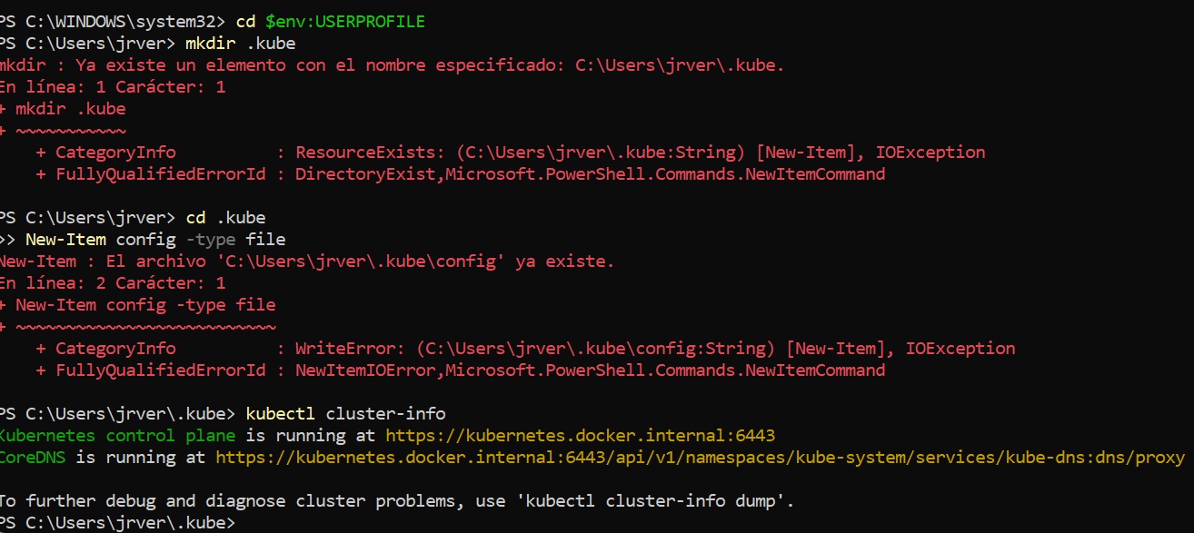
2. SET UP TOOLS
Kubectl: follow the great official guide -> https://kubernetes.io/docs/tasks/tools/
As admin in powershell:
Access to user directory
Create the directory “.kube” (if it not exist already)
> mkdir .kube
> cd .kube
> New-Item config –type file

Slide 11
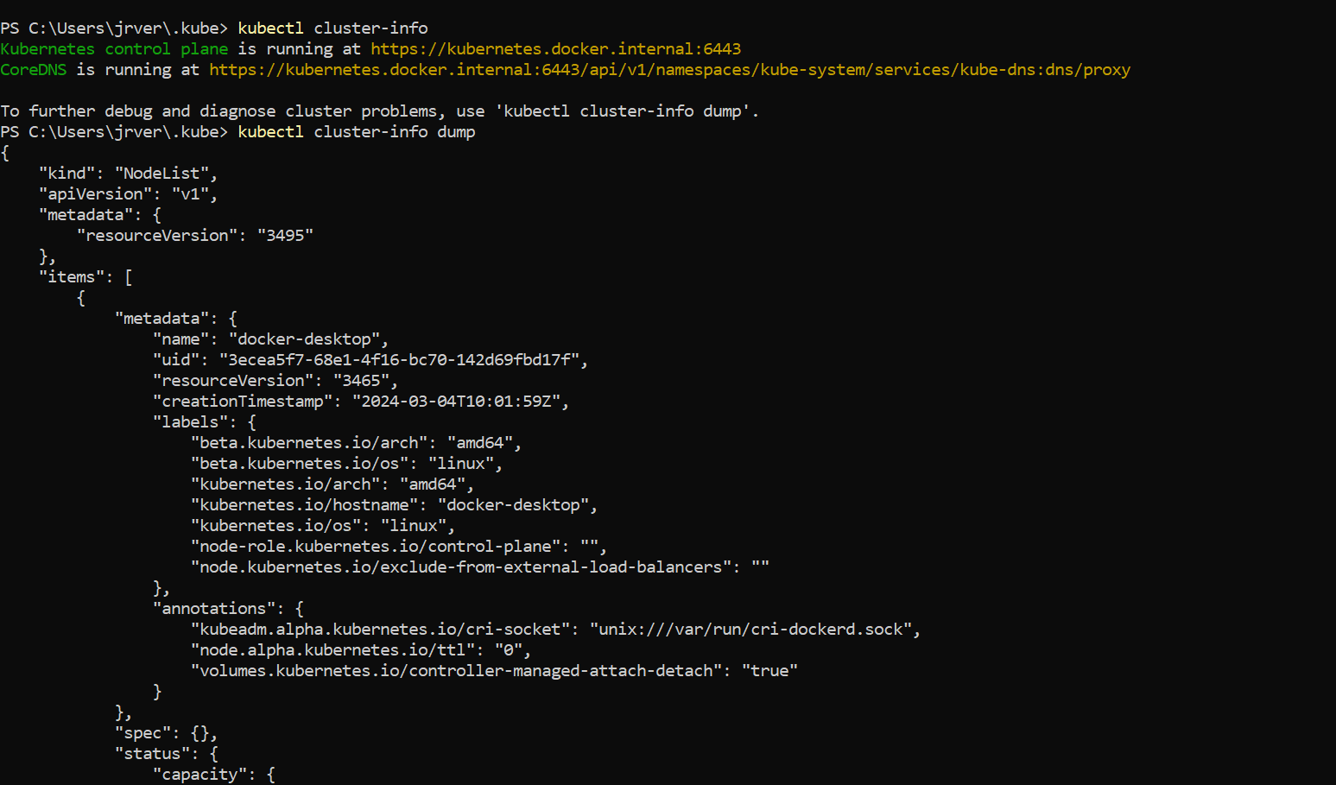
2. SET UP TOOLS
Kubectl: follow the great official guide -> https://kubernetes.io/docs/tasks/tools/
Check kubernetes cluster info:
> Kubectl cluster-info
Further debug and diagnose cluster problems
> Kubectl cluster-info dump

Slide 12
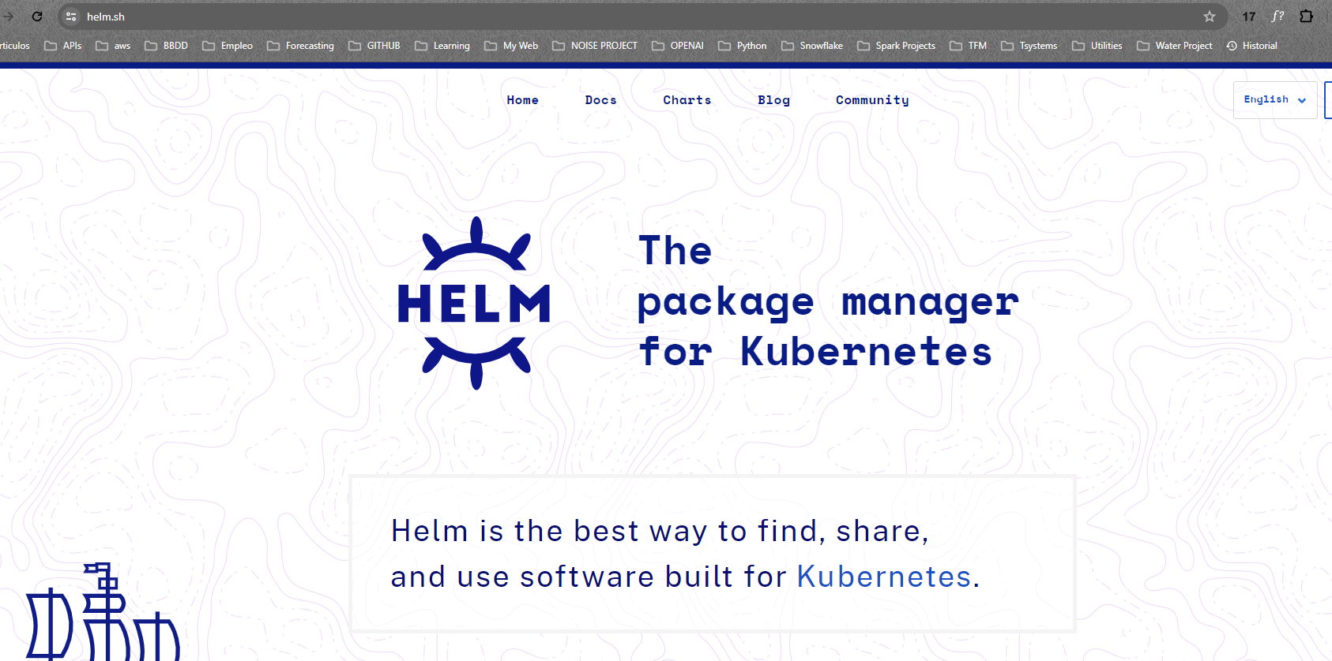
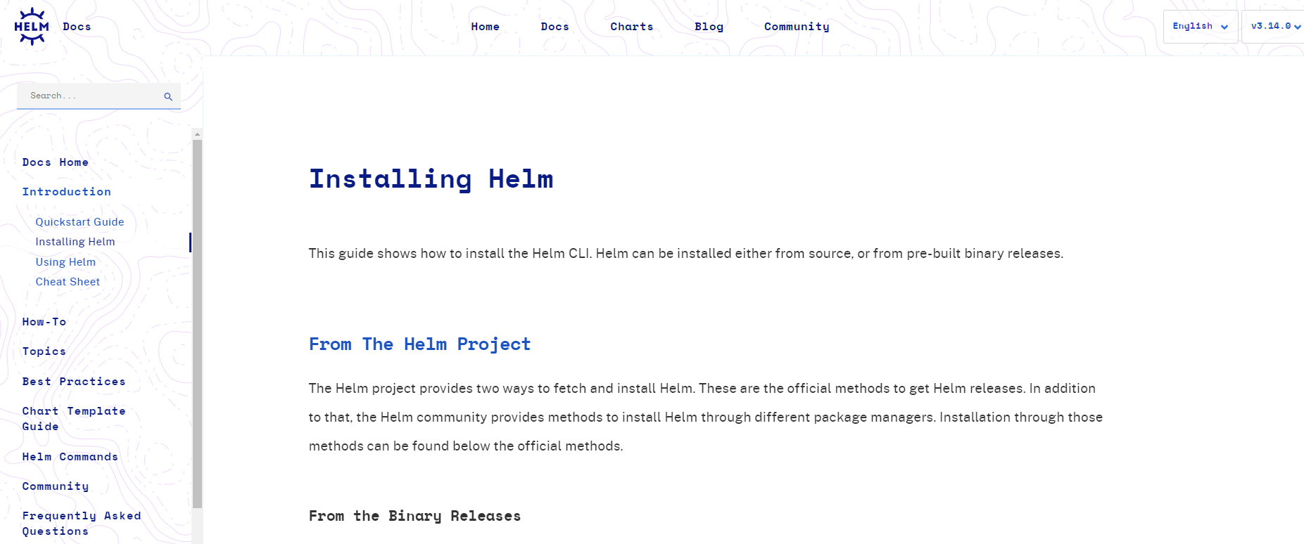
2. SET UP TOOLS
Helm: follow the great official guide -> https://helm.sh/docs/intro/install/
Choose the better way to install it according to your OS and preferences
In my case I performed Windows installation with chocolatey

Slide 13
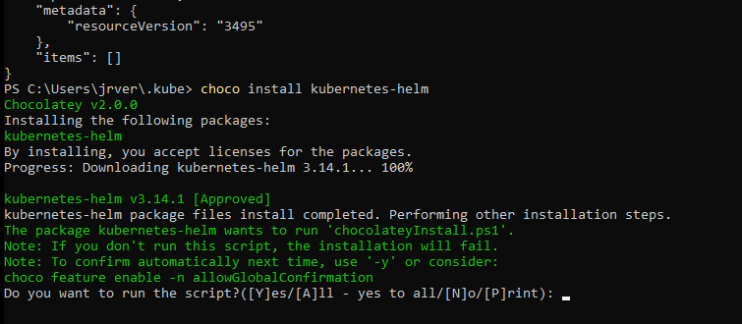
2. SET UP TOOLS
Helm: follow the great official guide -> https://helm.sh/docs/intro/install/
Choose the better way to install it according to your OS and preferences
In my case I performed Windows installation with chocolatey
> Choco install kubernetes-Helm
> Y

Slide 14
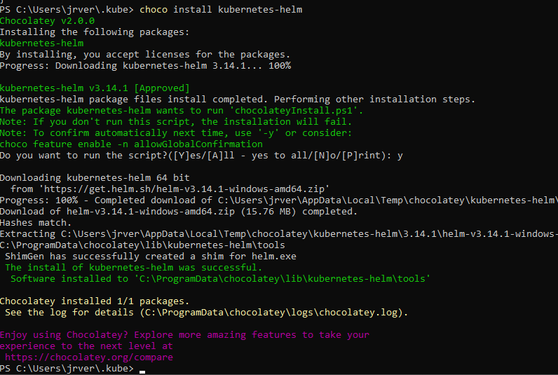
2. SET UP TOOLS
Helm: follow the great official guide -> https://helm.sh/docs/intro/install/
Wait for installing

Slide 15
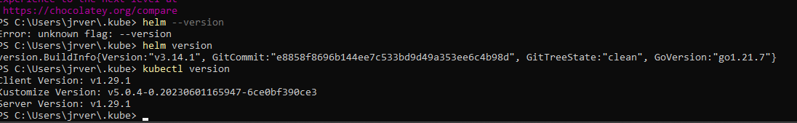
2. SET UP TOOLS
Helm: follow the great official guide -> https://helm.sh/docs/intro/install/
Confirm instalation –pointing to .kube directory
> Helm version

Slide 16
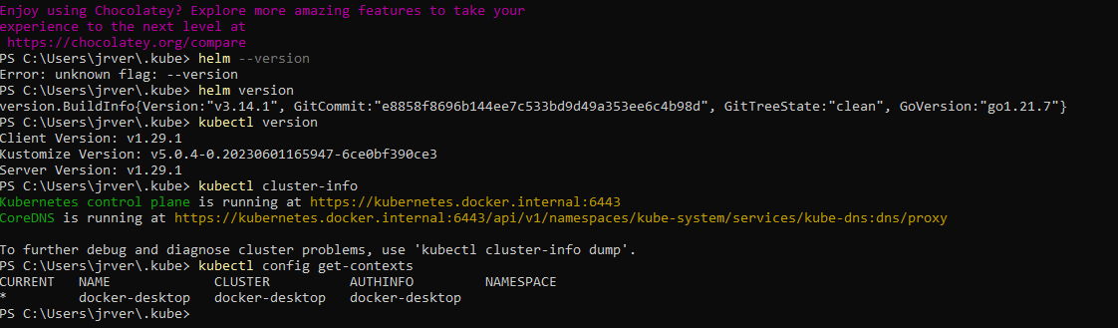
2. SET UP TOOLS
Check Kubernetes Cluster info and get current contexts
> kubectl cluster-info
> kubectl config get-contexts

Slide 17
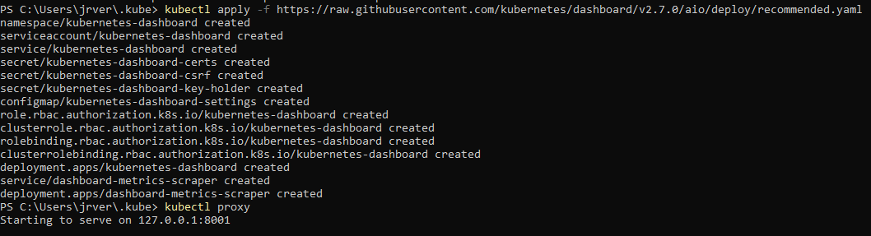
3. CONFIGURE KUBERNETES DASHBOARD
Pull the recommended .yaml for a default Kubernetes dashboard
> kubectl apply –f https://raw.githubusercontent.com/kubernetes/dashboard/v2.7.0/aio/deploy/recommended.yaml
After that it is needed to forwarding the ports to be able to see the dashboard on the browser
Open a new terminal o leave this terminal running, otherwise the fordwarding will be interrupted.
>kubectl proxy

Slide 18
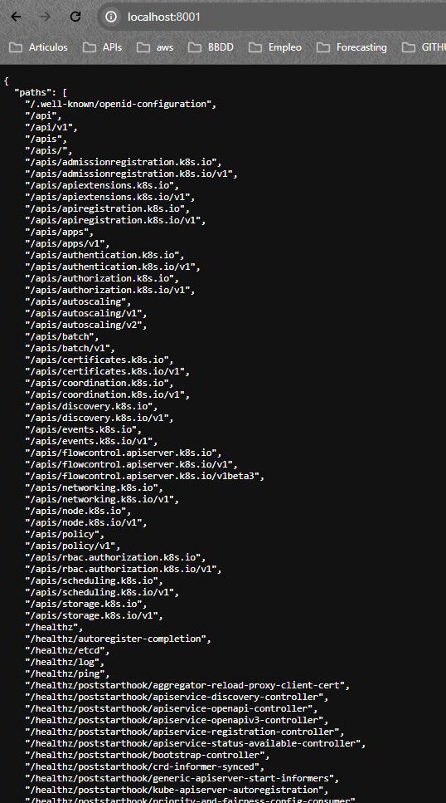
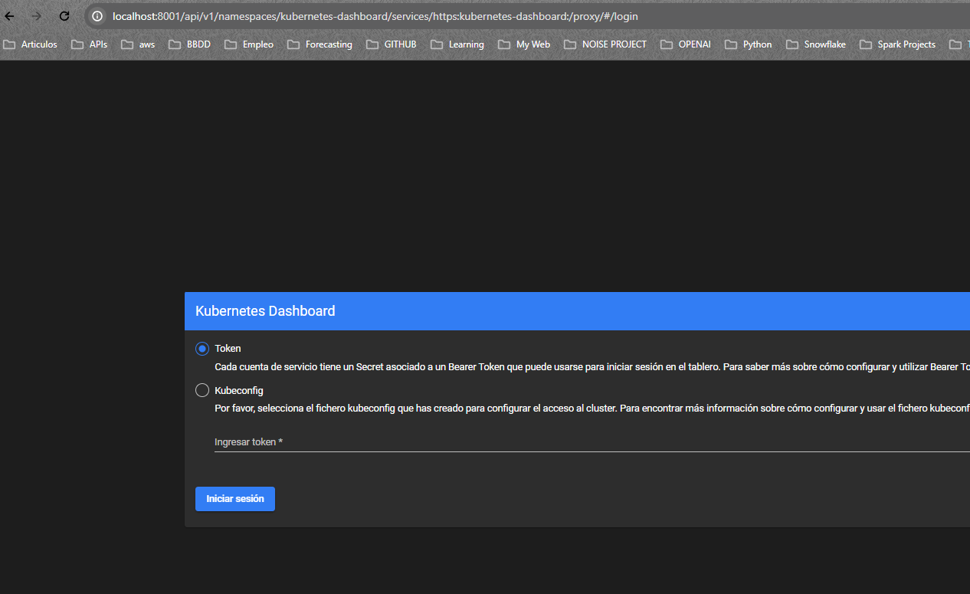
3. CONFIGURE KUBERNETES DASHBOARD
Go to localhost:8001 to see the paths you are able to see fro this dashboard
Paste the following command to get Access the dashboard:
> http://localhost:8001/api/v1/namespaces/kubernetes-dashboard/services/https:kubernetes-dashboard:/proxy/
The authentication screen is showed where is needed to pass the token

Slide 19
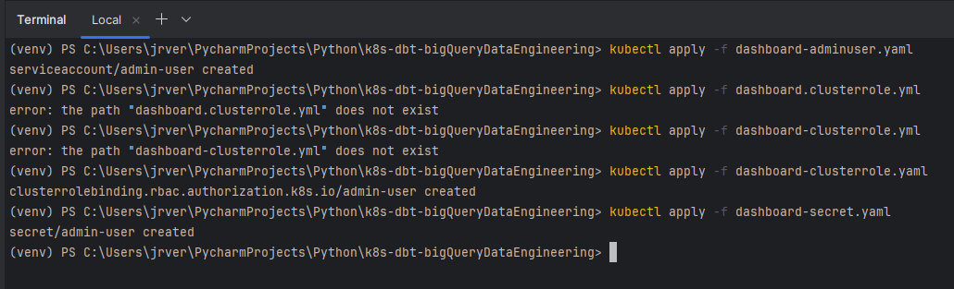
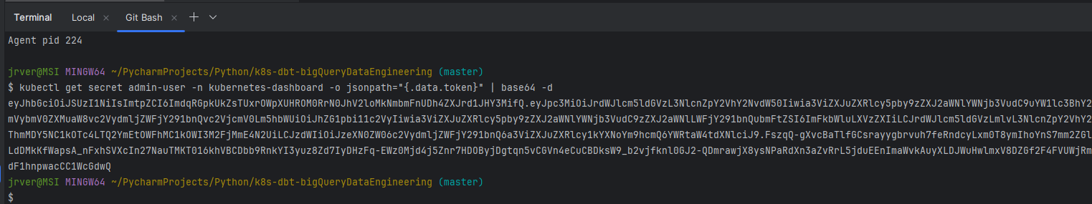
3. CONFIGURE KUBERNETES DASHBOARD
Before getting the Token, create and apply the dashboard services:
>kubectl apply -f dashboard-adminuser.yaml
>kubectl apply -f dashboard-clusterrole.yaml
>kubectl apply -f dashboard-secret.yaml
Once created, run the get secret command, copy and paste it into the authentication placeholder.
>kubectl get secret admin-user -n kubernetes-dashboard -o jsonpath="{.data.token}" | base64 -d

Slide 20
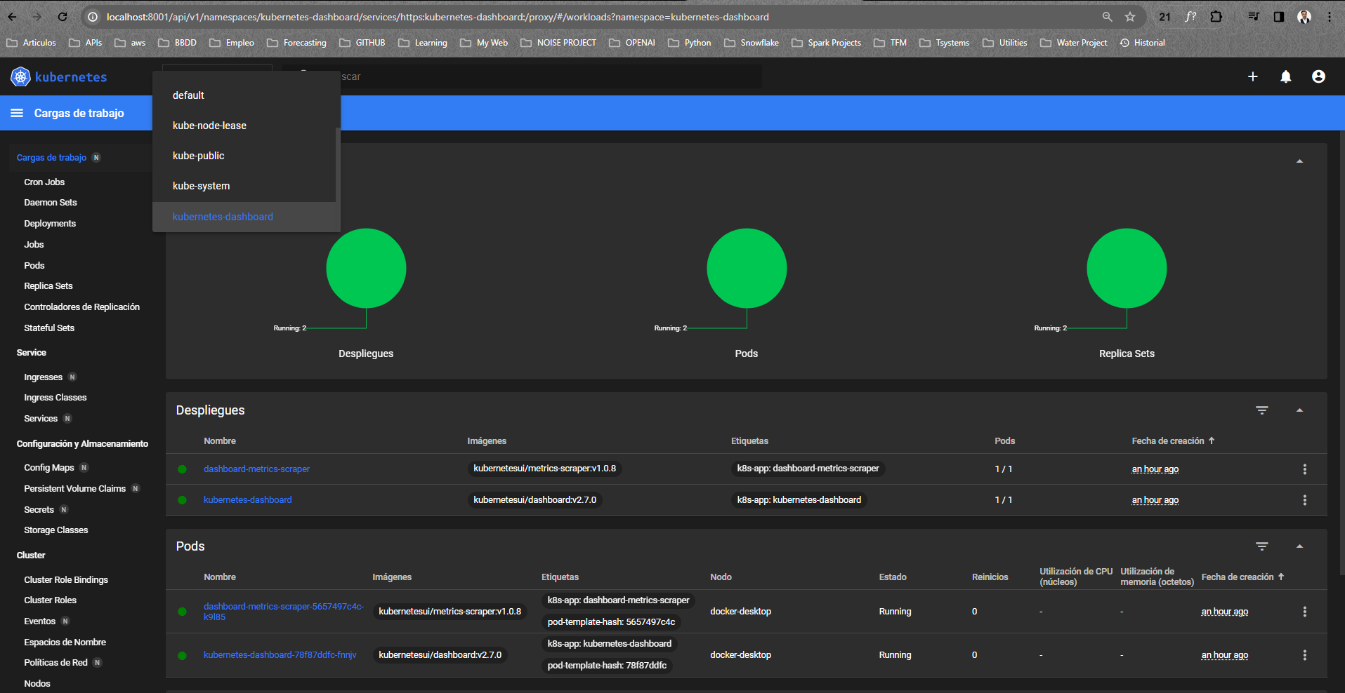
3. CONFIGURE KUBERNETES DASHBOARD
Copy, paste the token
Access granted and shows the full dashboard with comprehensive kubernetes, Jobs, pods, services information.

Slide 21
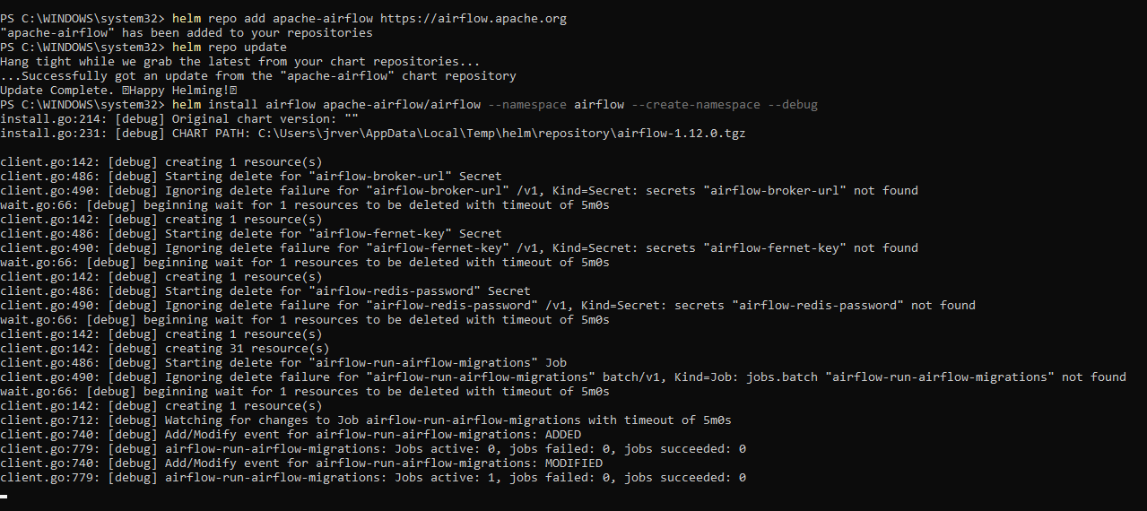
4. DEPLOY AIRFLOW PODS
Add airflow to the local Helm repository
> helm repo add apache-airflow https://airflow.apache.org
Update Helm repository to ensure it is up to date after adding airflow
>helm repo update
Install the airflow into a Kubernetes pod
>helm install airflow apache-airflow/airflow --namespace airflow --create-namespace --debug

Slide 22
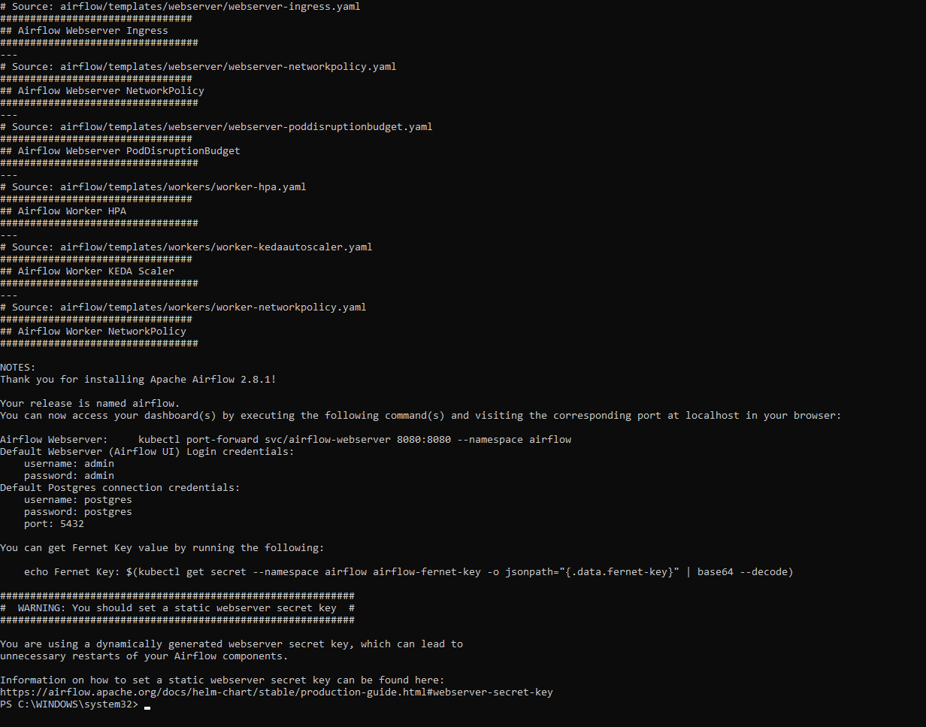
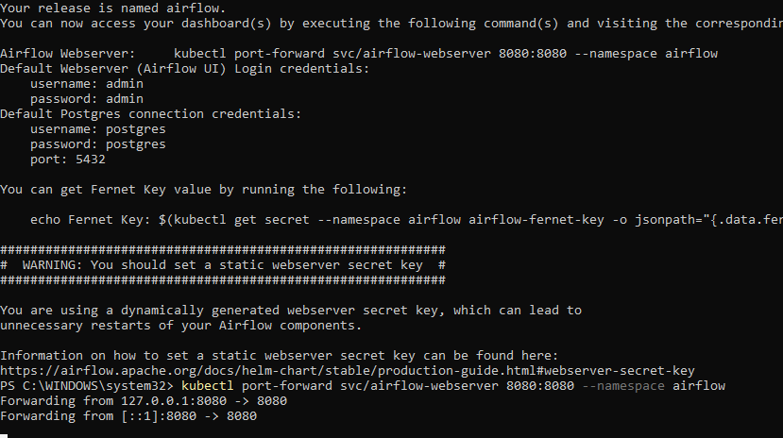
4. DEPLOY AIRFLOW PODS
Wait until instalation is finished
Forwarding port to enable the airflow UI on the browser by localhost 8080
>kubectl port-forward svc/airflow-webserver 8080:8080 --namespace airflow

Slide 23
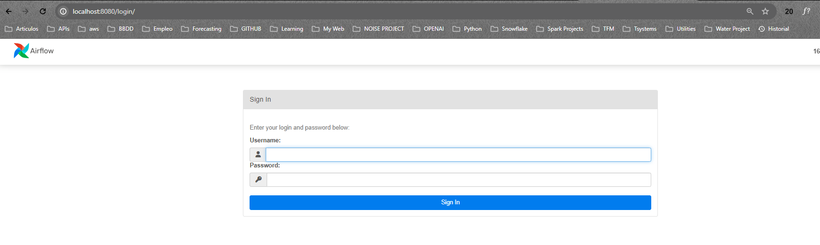
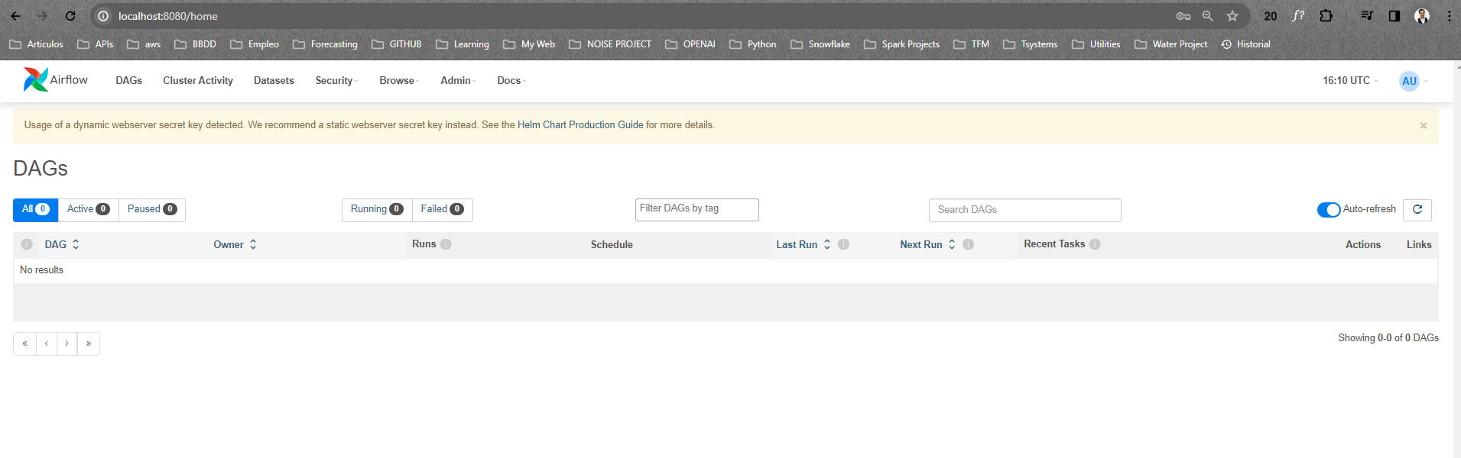
4. DEPLOY AIRFLOW PODS
Access the Airflow UI and type user and pwd in.
see a message about keys: " Usage of a dynamic webserver secret key detected" to solve this:
>helm show values apache-airflow/airflow > values.yaml
admin
admin

Slide 24
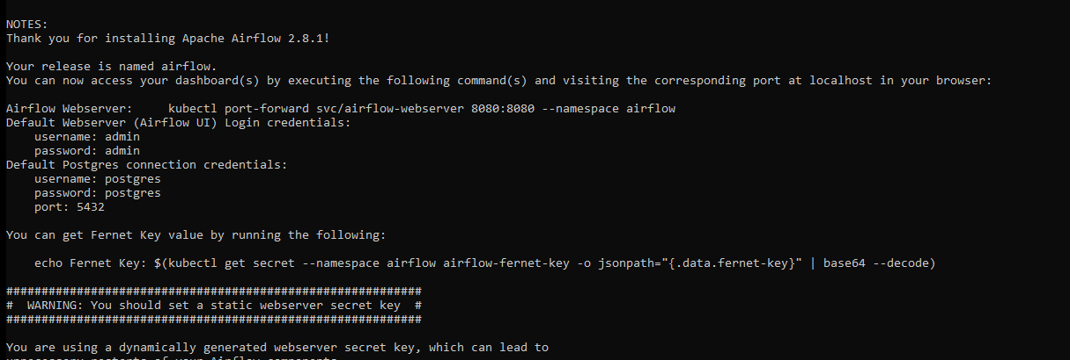
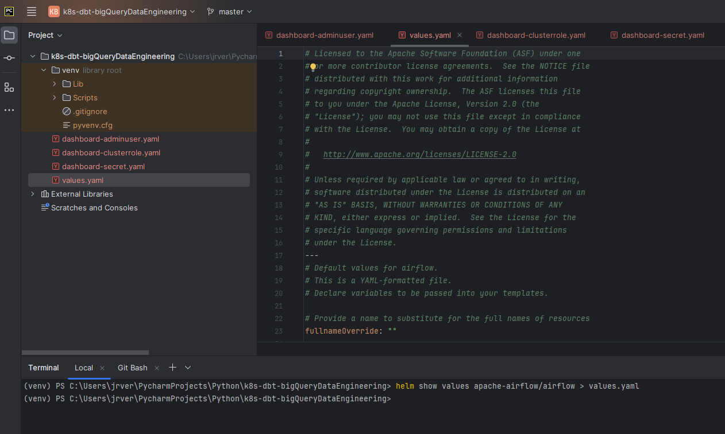
4. DEPLOY AIRFLOW PODS
Values.yaml is created and show default information which is going to overwritten.
1. the Fernet Key, the command is showed once Airflow pod is installed or upgraded.
> echo Fernet Key: $(kubectl get secret --namespace airflow airflow-fernet-key -o jsonpath="{.data.fernet-key}" | base64 --decode)
2. the values.yaml configuration – see next slide

Slide 25
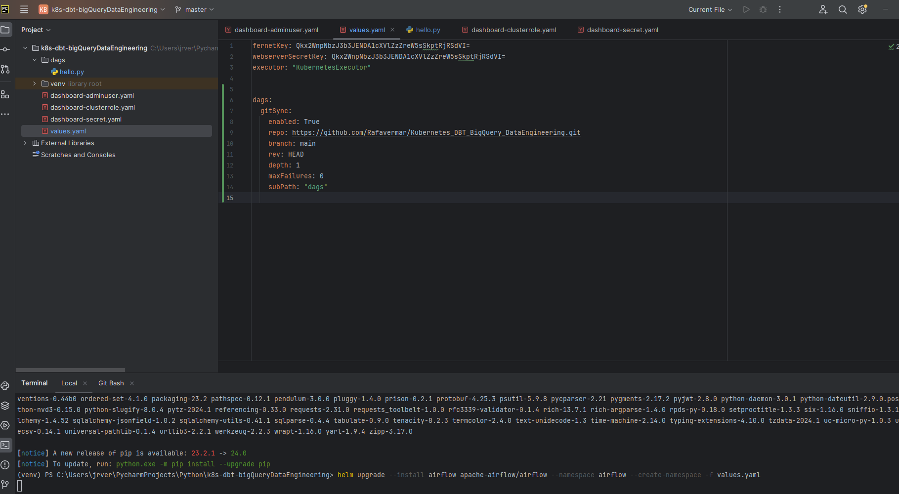
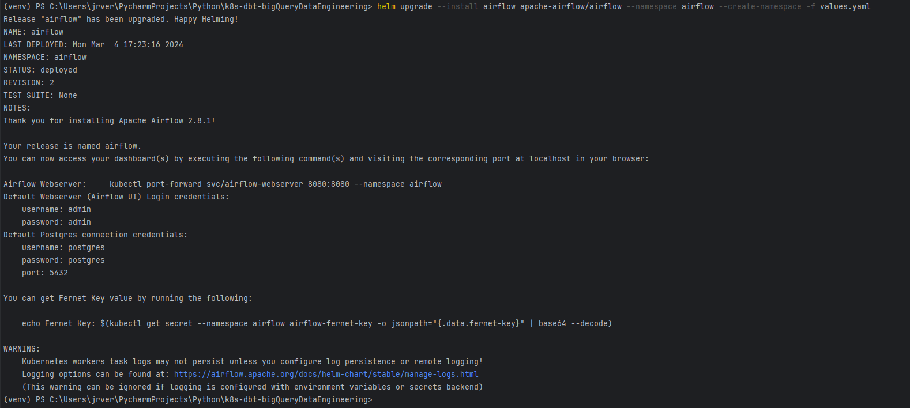
4. DEPLOY AIRFLOW PODS
Values.yaml must look like this.
You need a github repo to be synchronized with and from where your pushed DAGs will be read by the Airflow pod.
Upgrade Airflow pod:
> helm upgrade --install airflow apache-airflow/airflow --namespace airflow --create-namespace -f values.yaml

Slide 26
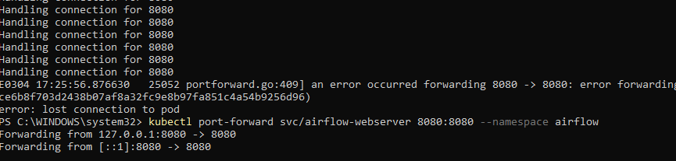
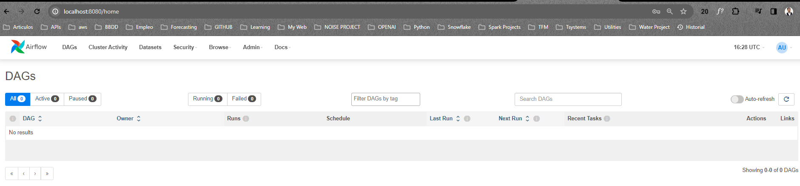
4. DEPLOY AIRFLOW PODS
Forward ports again
See Airflow UI without any message

Slide 27
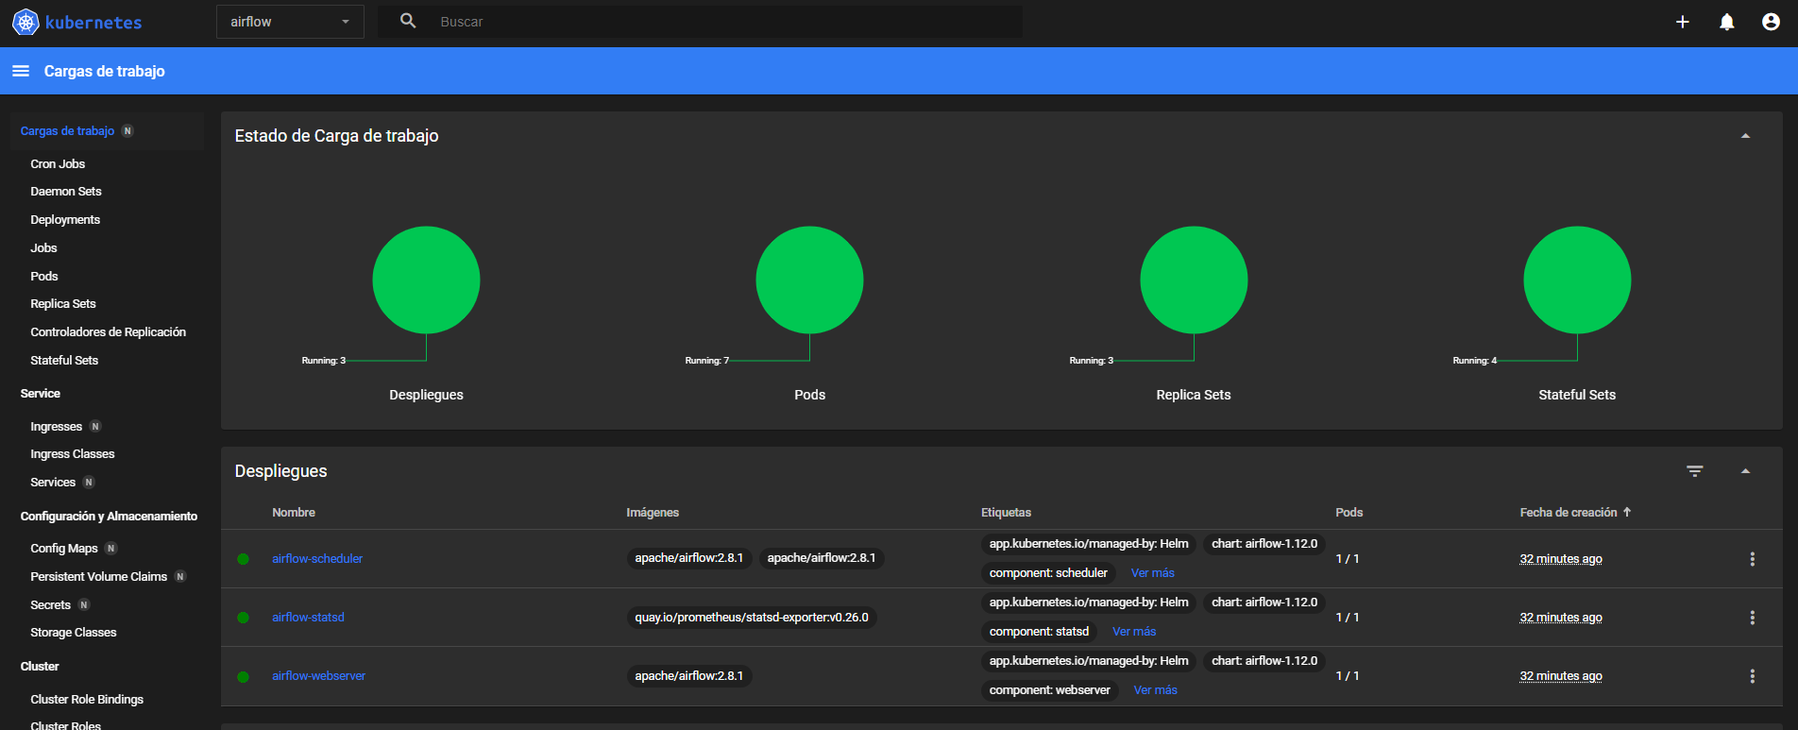
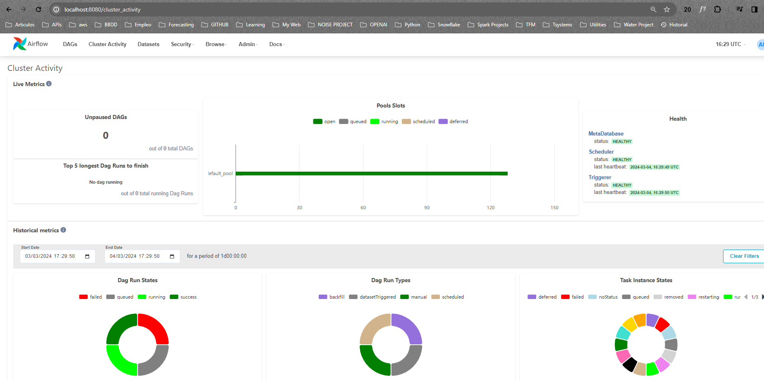
4. DEPLOY AIRFLOW PODS
In Airflow UI go to Cluster Activity to see further information about Dag and cluster performance.
In Kubernetes Dashboard confirm the pods are running as expected.

Slide 28
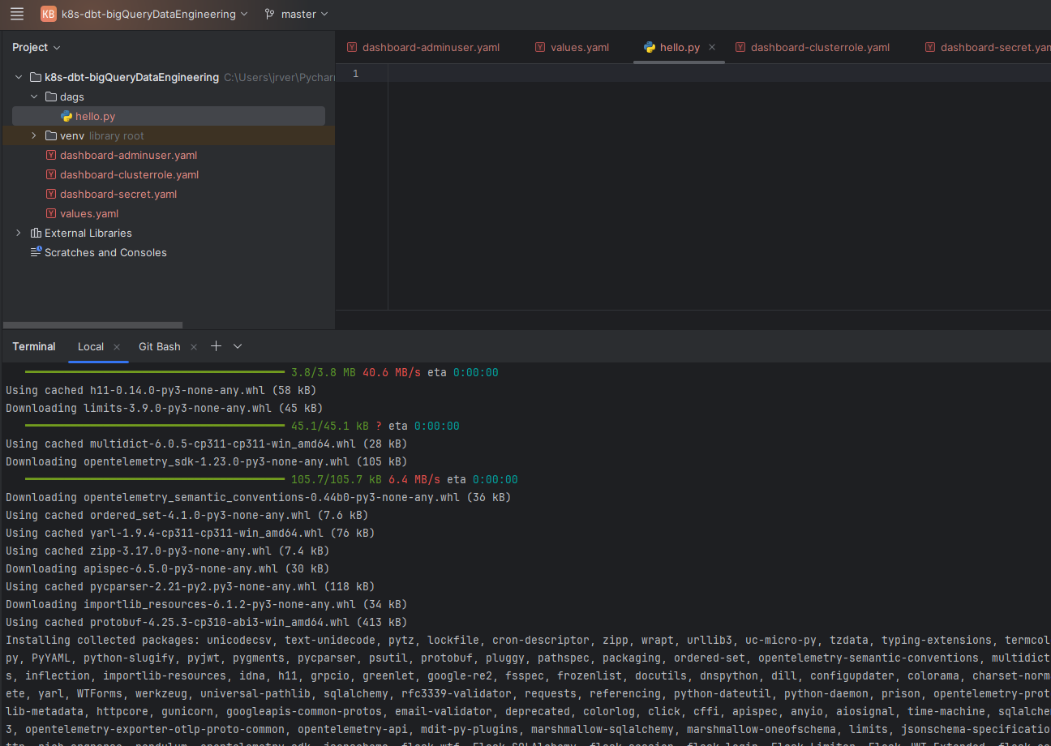
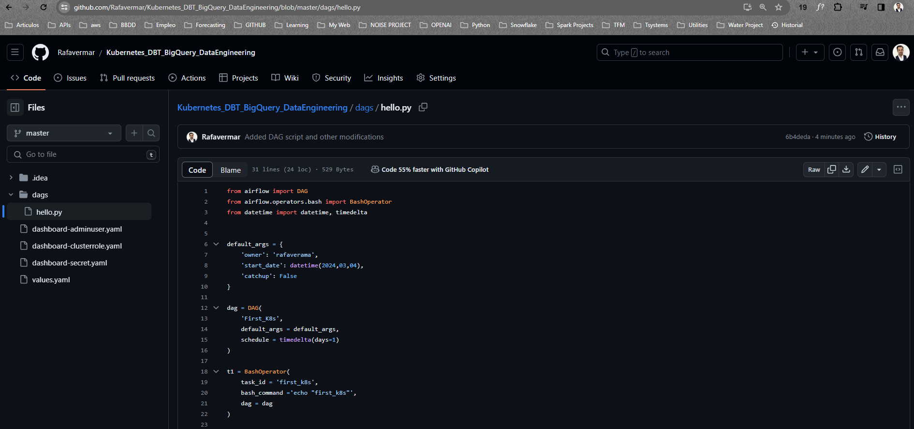
4. DEPLOY AIRFLOW PODS
Create the first DAG “hello.py”.
Push your code to github (your values.yaml should have the repo sync as showed before).
Install airflow locally and any needed dependencias to avoid the IDE to show errors by missing packages.
>pip install apache-airflow
The DAG dbt_bq_final.py needs the KubernetesPodOperator. Install it with this:
>pip install apache-airflow-providers-cncf-kubernetes

Slide 29
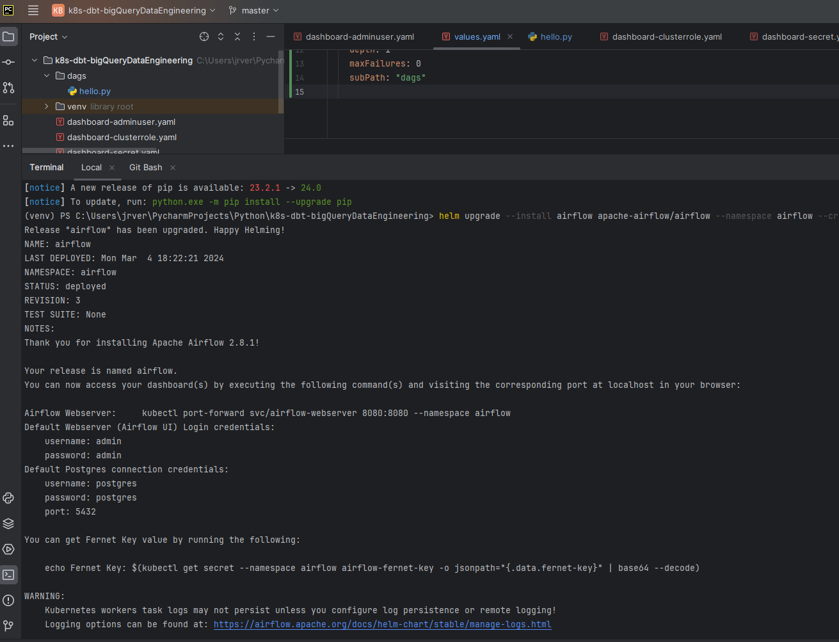
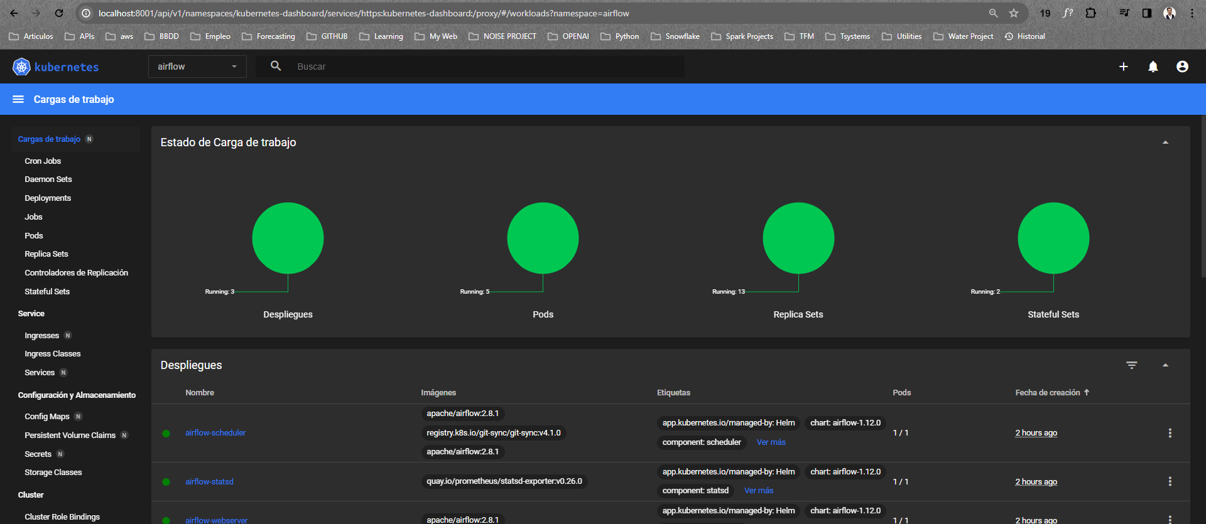

Slide 30
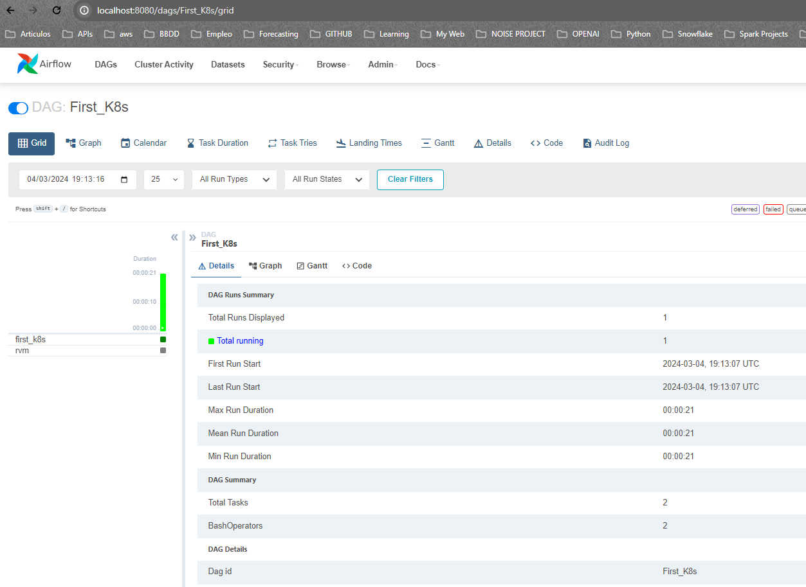

Slide 31
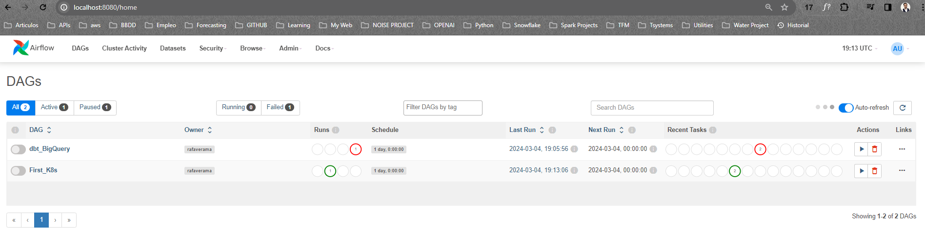

Slide 32
5. STABLISH LOG PERSISTENCE FOR AIRFLOW

Slide 33
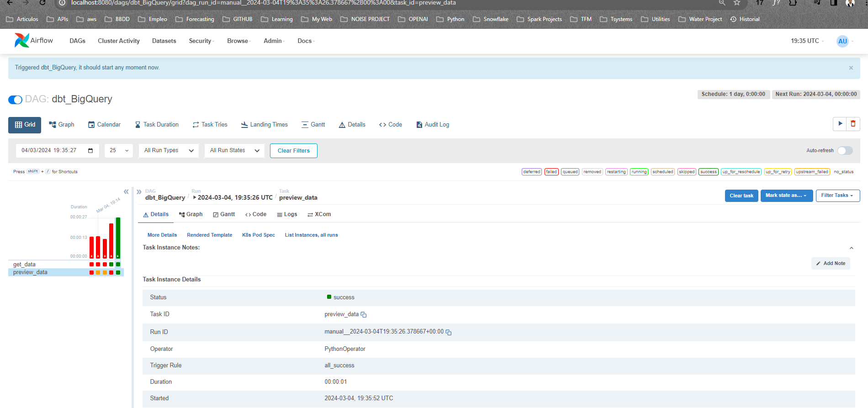

Slide 34
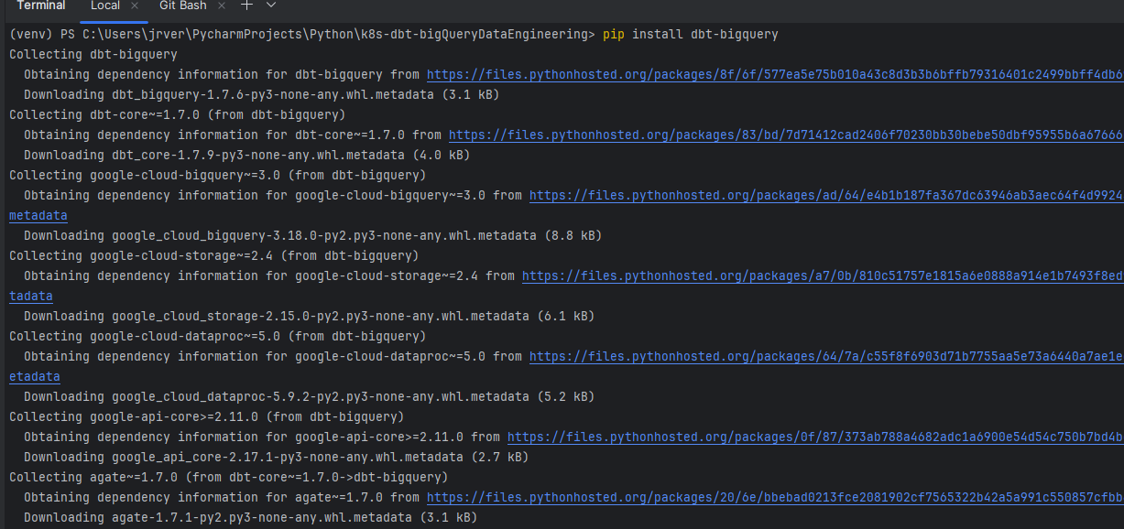

Slide 35
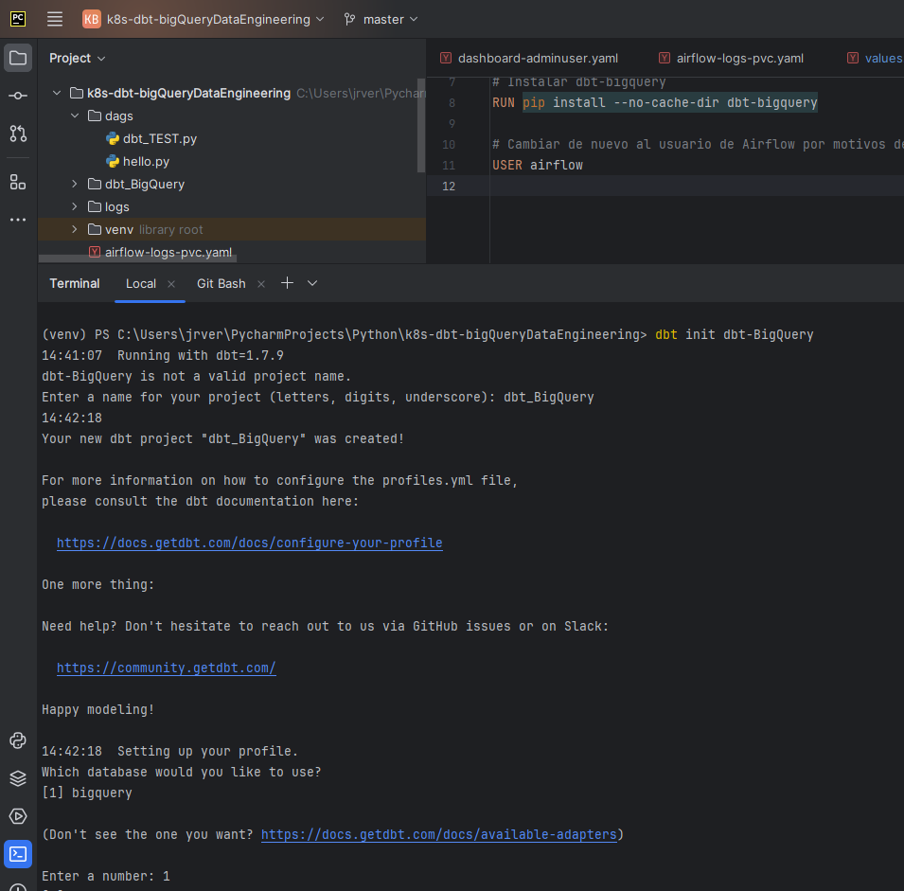

Slide 36
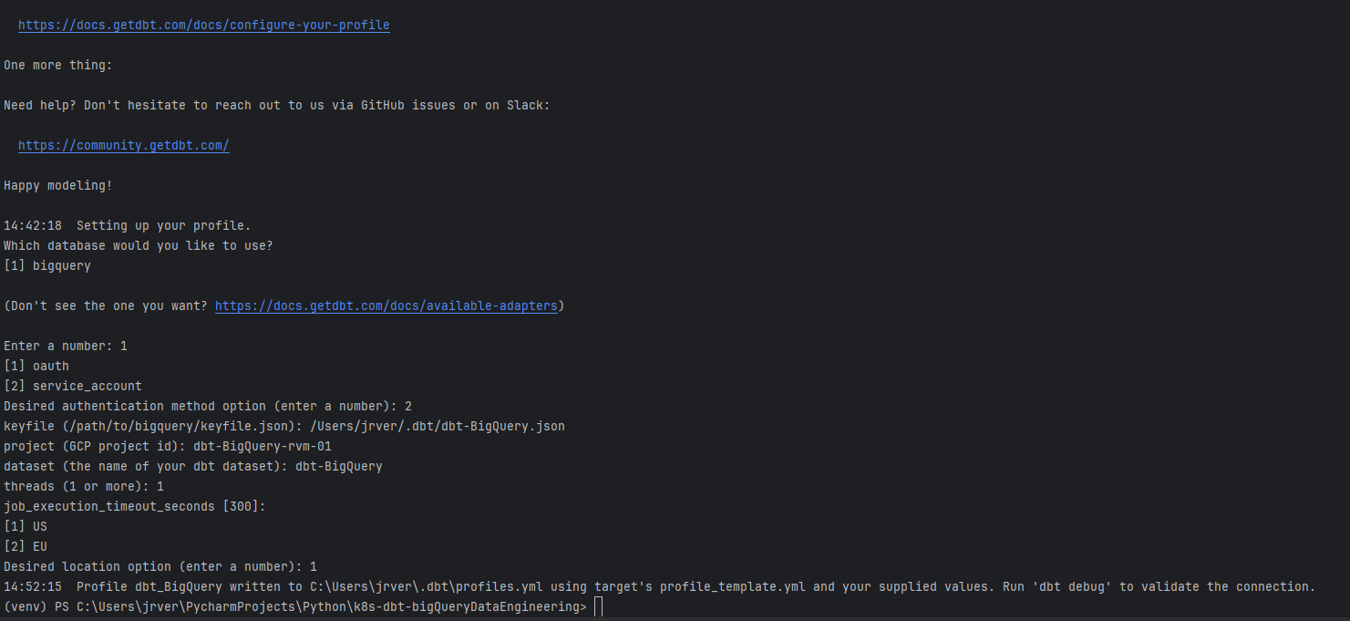

Slide 37
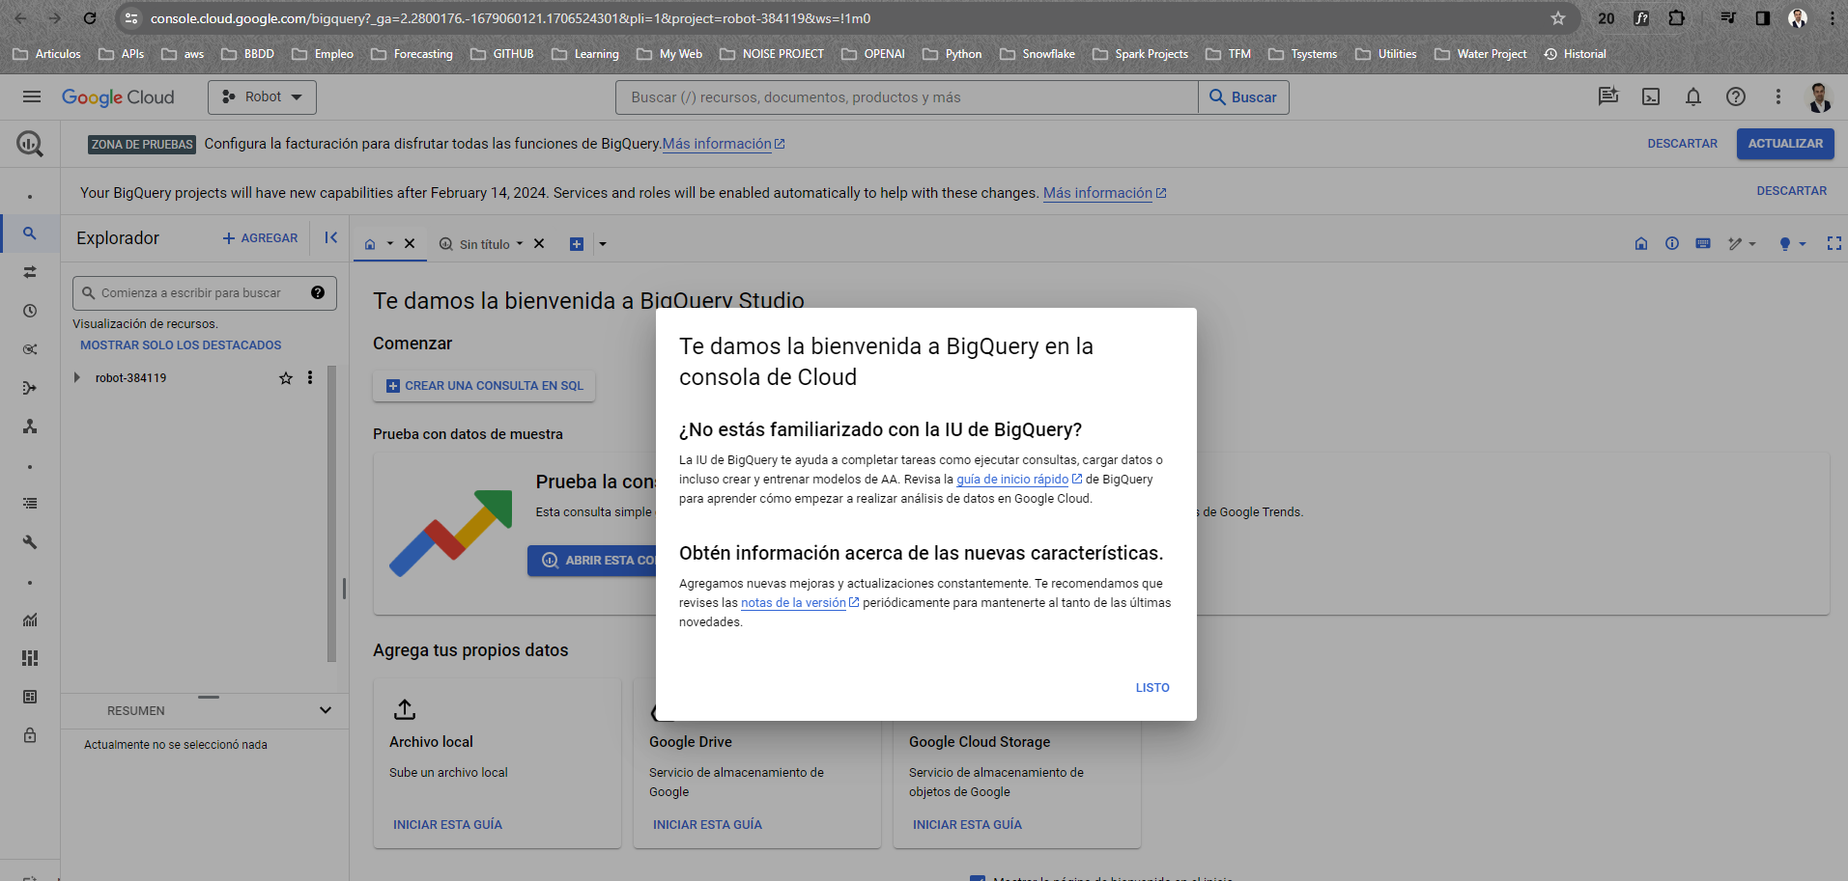

Slide 38
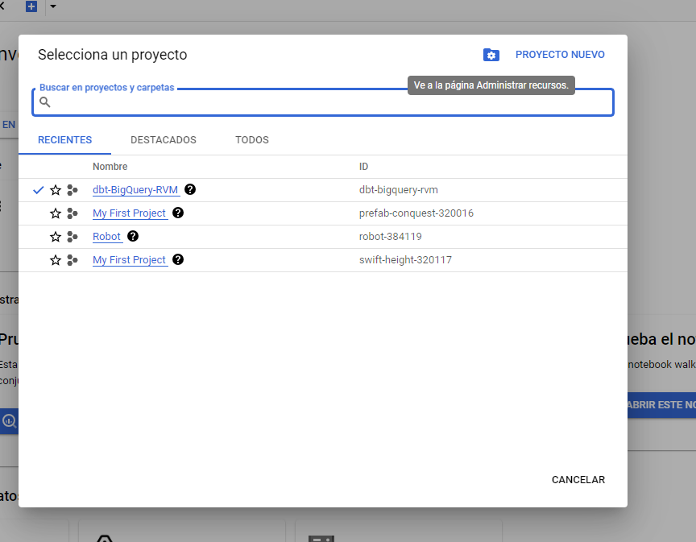
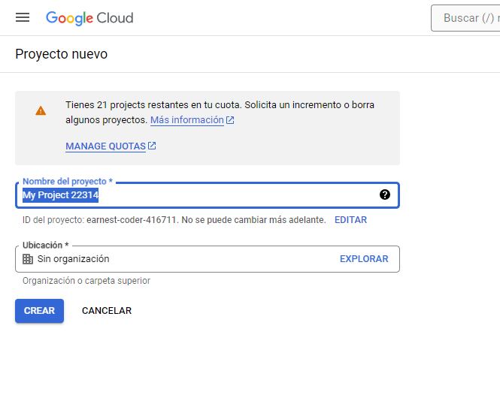

Slide 39


Slide 40


Slide 41


Slide 42


Slide 43


Slide 44


Slide 45


Slide 46


Slide 47


Slide 48


Slide 49


Slide 50


Slide 51


Slide 52


Slide 53


Slide 54


Slide 55


Slide 56


Slide 57


Slide 58


Slide 59


Slide 60


dbt clean
dbt deps

Slide 61


Slide 62


Slide 63


Slide 64


Slide 65


Slide 66


Slide 67


Slide 68


Slide 69


Slide 70


Slide 71


Slide 72



Slide 73

Comillas son apostrofes `dbt-tutorial`

Slide 74


Slide 75


Como una vista

Slide 76

Como una tabla

Slide 77


Slide 78



Slide 79


Slide 80


Dbt seed incluido en el DAG

Slide 81



No cambié el nombre al commit

Slide 82


Slide 83


Slide 84


Slide 85


Slide 86

NOMBRES DAG DEFINITIVOS

Slide 87


Slide 88


Slide 89



